Slide 1
How Insightful!
Grok Your ASP.NET Core Web Apps with Application Insights Azure Monitor

Slide 2

Hi! I’m Cam. I work for Microsoft.

Slide 3
What we’ll cover
What Azure Monitor is and why you need it
Viewing Application Insights telemetry
Instrumenting your app for Application Insights
Using telemetry in our ASP.NET Core app to solve:
A performance bottleneck
An unhandled exception

Slide 4
Why you need Azure Monitor
(Unless you really like a challenge)

Slide 5

Production debugging under pressure

Slide 6
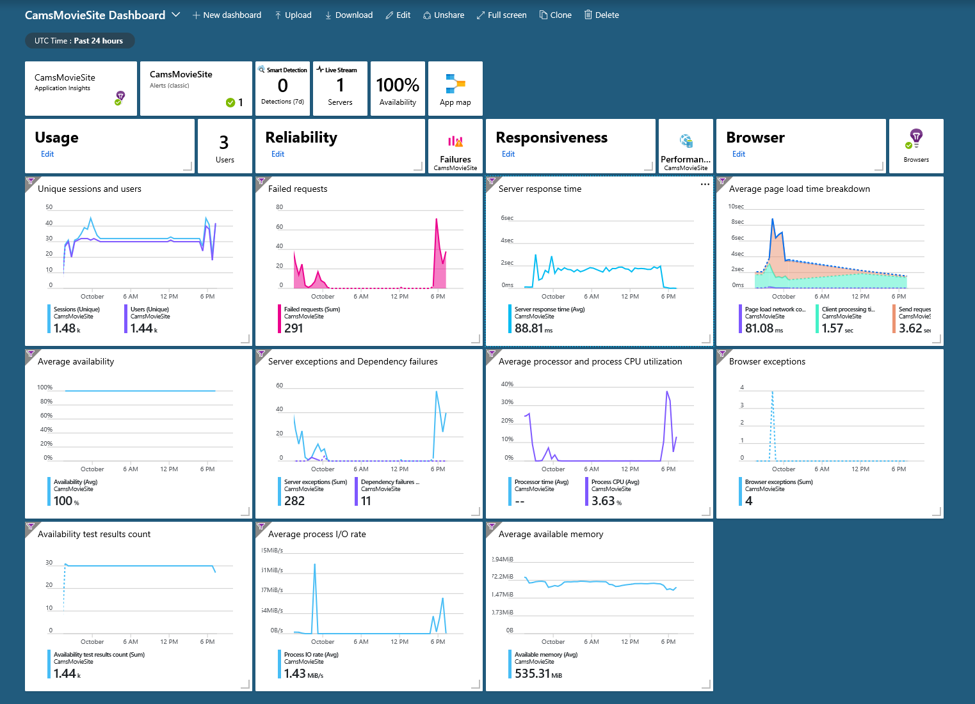
A plethora of useful Insights

Slide 7
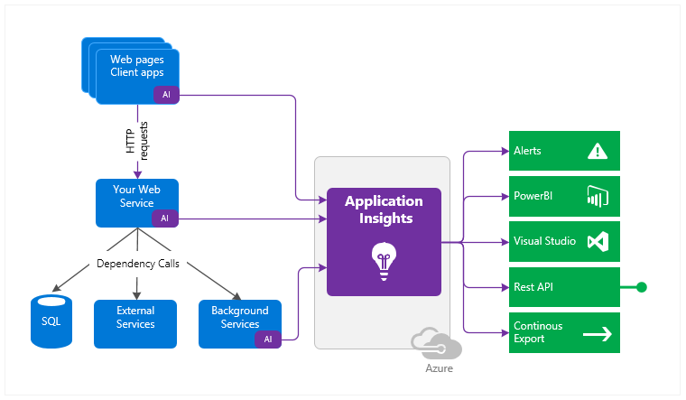
Where did you come from, where did you go?

Slide 8
Demo – Show me the insights!

Slide 9
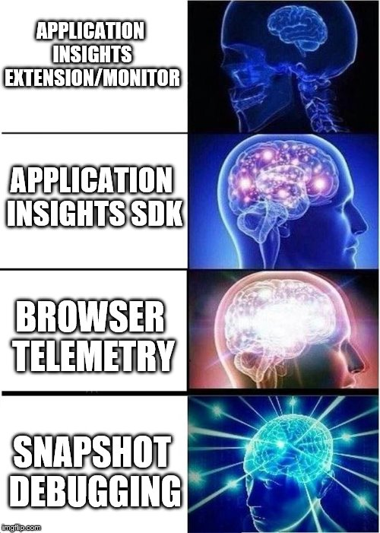
Instrumentation escalation

Slide 10
Demo – Instrumentation and Insights

Slide 11
Conclusion
We’re almost done!

Slide 12
What’s next?
https://github.com/camsoper/how-insightful
Things we didn’t get to
Profiling (currently broken for ASP.NET Core 2.1)
Analytics (machine learning)
Alerts
Excellent docs! https://docs.microsoft.com/azure/monitor

Slide 13
Questions?

Slide 14


Thank you! @CamSoper CamSoper

